Slide 1
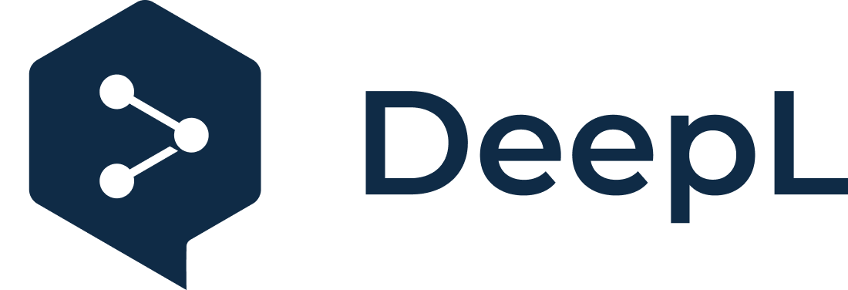
Subscribe to DeepL Pro to edit this document.
Visit www.DeepL.com/pro for more information.

Slide 2
Heterogeneous Systems Integration
Iván García-Magariño

Slide 3
Introduction
IoT often has heterogeneous applications
EAI (Enterprise Application Integration) facilitates systems integration
Service integration practice in different languages
Standard documents for information exchange (e.g. XML)

Slide 4
EAI (Enterprise Application Integration) (1)
EAI uses intermediate software known as middleware
Integration with EAI can reduce time-to-market for novel products.
EAI allows you to recover your investment by reusing different applications.
EAI allows you to overcome chaotic architectures by managing their complexity, properly training your personnel

Slide 5
EAI (2)
EAI is the creation of enterprise solutions by combining applications using middleware
Middleware are the application-independent services that mediate between applications.
EAI with middleware allows:
Package functionality as services for other applications (e.g. an IoT garbage collection application can determine which is the nearest empty garbage can)
Applications can share information with other applications
Coordinate business processes with different applications

Slide 6
EAI facilitates new critical solutions
Improve customer relations
It allows a more global vision of each customer, and the customer perceives an integrated service.
Improved supply chain relationships
XML (eXtensible Markup Language) facilitates communication between applications.
EAI improve internal processes
Reduces time to market for new applications

Slide 7
The Web at EAI
The web has been a key factor in the rise of the EAI
Dot-com refers to companies that do most of their business on the Internet.
The web is ubiquitous and enables rapid business growth

Slide 8
Examples of Middleware
Message Oriented Middleware (MOM)
Common Object Request Broker Architecture (CORBA)
Microsoft Distributed Component Object Model (DCOM)
Enterprise Java Beans (EJB)

Slide 9
Barriers to effective EAI
Chaotic architectures
APIs (Application Programming Interface) allow you to provide other applications with access to your functionality or data.
Lack of staff skills
Middleware skills such as MOM, CORBA, DCOM and EJB are required.
Safety Failures

Slide 10
Types of Integration (1)
Integration can occur at three points:
Presentation
Functionality
Data layer
One objective of integration is to reduce coupling
Tightly coupled integration can be a serious maintenance problem
Integration into the presentation can be easy but very limiting

Slide 11
Types of Integration (2)
Data-level integration provides more comprehensive solutions than presentation-level integration, but may require rewriting some of the software.
Functional integration is the most important model but the most complex one
There are three types of functional integration:
Consistency of data
Multi-step processes (multistep)
Plug-and-play components

Slide 12
Integration Model
An integration model is an approach and setup for integrating software
The most relevant aspects to be taken into account are:
Simplicity of integration
Reusability of integration for different configurations
Breadth of possible approaches to integration
Experience required to perform the integration
An integration model defines how the applications will be integrated indicating the nature and mechanisms of integration

Slide 13
Presentation Integration Model (1)
The presentation integration model integrates new software through existing presentations.
This is usually done to create a new user interface.
Can be used to integrate various applications

Slide 14
Presentation Integration Model (2)
When to use it:
To provide more usable UIs (user interfaces)
For the user to perceive as one application the composition of several applications, simply with a common UI.
When the only useful point of integration is through its presentation.
Examples of Integration:
Providing a Windows interface for accessing various applications
Providing a unified HTML interface for various applications
Providing a Java-based interface for access to multiple applications

Slide 15
Presentation Integration Model(3)

Slide 16
Data Integration Model
The data integration model directly integrates databases and data structures.
Sometimes, it is as simple as accessing the database management system (DBMS) of another application for the coordination
A data access middleware facilitates database access through the use and creation of connectors.

Slide 17
Tools and middleware for data integration
Batch file transfer
ODBC (Open Database connectivity)
Middleware for access to distributed databases
Data transformation: It allows passing data from one database to another destination for use and transfer of information.

Slide 18
Integration in the data access layer

Slide 19
When to use integration at the data layer
To combine information from different sources for analysis and decision making
To provide multiple applications with read access to a common source of information
To allow information to be extracted from one source of information, and reformatted and updated in another source of information.

Slide 20
Functional Integration Model
Business logic is the implementation of the business process in a programming language.
Business logic contains the rules necessary to properly interpret or construct the data and is not always available through presentation.
Functional integration integrates business logic

Slide 21
Distributed processing middleware
Distributed processing middleware is software that facilitates the communication of requests between different software components through the use of interfaces or messages.
Provides the execution environment for handling requests between software components

Slide 22
Types of distributed processing middleware
Message-oriented middleware (MOM): Performs integration by means of message passing between applications.
Distributed object technology: This middleware allows software components to be used as objects. A well-known example is CORBA
Processing transaction monitors: Enables distributed architectures by performing transactions with concepts such as "two-phase commit" of a transaction.

Slide 23
Functional Integration

Slide 24
Types of functional integration
Data consistency: The updating of information in one or more sources is coordinated among the various integrated applications.
Multi-step processes: A set of applications are coordinated to perform coordinated actions executed in the different integrated applications.
Plug-and-play components: Creation of reusable interfaces that simplify the creation of new applications.

Slide 25
Example of Functional Integration for data consistency

Slide 26
Example of multi-step Process Integration

Slide 27
Connect-and-Ready Component Integration Example

Slide 28
Practical example of connector between Java and Python
Download JPython jar file (standalone version)
Creating a Java project with NetBeans or similar
Include Jpython jar file in Java project
Creating a class in Java (see following slides)
Creating a Java program (see the following slides)
Calling from Java program to Python program

Slide 29
Example of Class that facilitates communication between Java and Python

Slide 30
Using the interpreter to call the Python program from Java
You need the code of the previous class

Slide 31
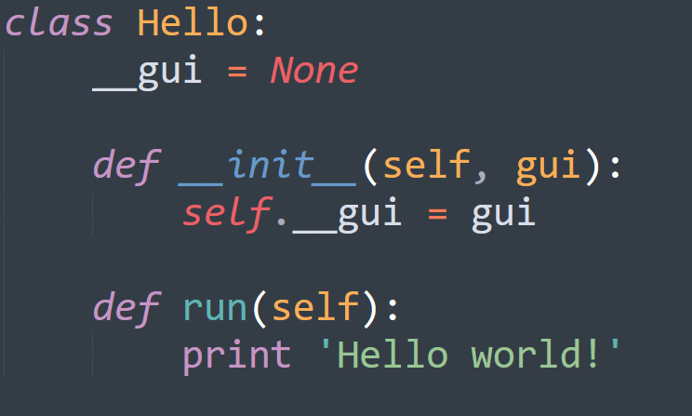
Python program called from Java

Slide 33
Disadvantages of Jython connector and alternatives
Cannot run some libraries
For example Scikit-learn
Alternative:
Expose scikit-learn or other libraries in a HTTP/Json service
Use microframeworks such as flask, bottle or cornice

Slide 34
Bottle: Python Web Framework
- Bottle's website: http://bottlepy.org/docs/dev/
- Installation, run from console:
pip install bottle
- Write a python program like the following example (in the next slide)
-

Slide 35
Python program using Bottle
@route indicates the route by ascocicating it with a function

Slide 36
Access from HTTP
Web access:
Example browser access

Slide 37
Python console output when bottle is run

Slide 38
Using the Bottle framework to integrate a neural network with Python
Check the way in which
The input GET parameters are received,
Neural network is created/trained/applied with Scikit-learn library, and
Output is returned

Slide 39
It can be tested in a browser using GET parameters:
URL with parameters x1 and x2:
http://localhost:8080/integration?x1=0&x2=1
In this case, "0" is the result of sorting (x1,x2) = (0,1)

Slide 40
Integration of a Java System with neural network classification in Python
In any Java program
Add GET parameters to the URL
Make an HTTP request to the localhost or to the corresponding website.
Set a time limit (i.e. timeout)
Read program output in Python
In this example, the output of a neural network (Multi-layer Perceptron) implemented with the Scikit-learn library is read.
Scikit-learn website:

Slide 41
Example of an integrated Java program
with the neural network in Python

Slide 42
MOM (Message-oriented Middleware) (1)
Secure communication
Message queuing
Directory support
Distributed communications
MOM does not model communications as remote method invocations (unlike CORBA for example).

Slide 43
MOM (2)
Support message passing
Message passing is non-blocking
MOM allows posting and subscribing to channels to send and receive messages
Basic MOMs allow only direct messages
Advanced MOMs enable cross-platform switching

Slide 44
MOM(3)
MOM Advantages:
Simple, just publish and subscribe
Easy to install and use, unlike remote calling methods with CORBA.
Generic and can be used between heterogeneous applications
Flexible, it is not restrictive in what it sends, it simply sends it.

Slide 45
MOM (4)
Disadvantages of MOM
Because it is so generic, applications are in charge of interpreting the messages.
Developers are often unfamiliar with
Asynchronous, it can be difficult to work with programs with blocking messages in a natural way, since MOM is non-blocking.
Messages have no structure and can be more difficult to interpret.
Non-standard: MOM only facilitates communication but messages must be interpreted by the application.

Slide 46
MOM (5)
When to use MOMs:
When applications need messages
When you do not want to mix programming with call definition.
When CORBA or similar are very complex
When remote calls are very rudimentary

Slide 47
MOM design considerations
The Message Bus connects various applications
The "Channel" class is the message bus interface.
The "ChannelListener" classes are used to listen for messages
The "ChannelsUpdateListener" class is used to receive notifications from the listening channel.
MessageBus interface and MessageBusSocketImpl class allows communication with the world outside the app.

Slide 48
Use of MOM in client (1)
Establish an instance of the message bus:
Channel. setMessageBus (new MessageBusSocketImpl (BROKER_NAME, BROKER_PORT));
Subscribe to a channel
Channel textChannel = Channel.subscribe ("text_channel", this);
Post a message in the channel:
textChannel. publish (new String (myID + " says Hello!"));

Slide 49
Use of MOM in client (2)
Unsubscribe from a channel:
textChannel. unsubscribe (ChannelListener);
Get a list of channel names:
Enumeration Channel. getChannelNames ();

Slide 50
MMO Interfaces
The ChannelListener class should be implemented by any object that wants to
Be notified when a message is received from a calna
The ChannelsUpdateListener interface has to be implemented by any
object you want to be notified when a channel is added

Slide 51
Example of MOM

Slide 52
Example implementation of the above interface

Slide 55
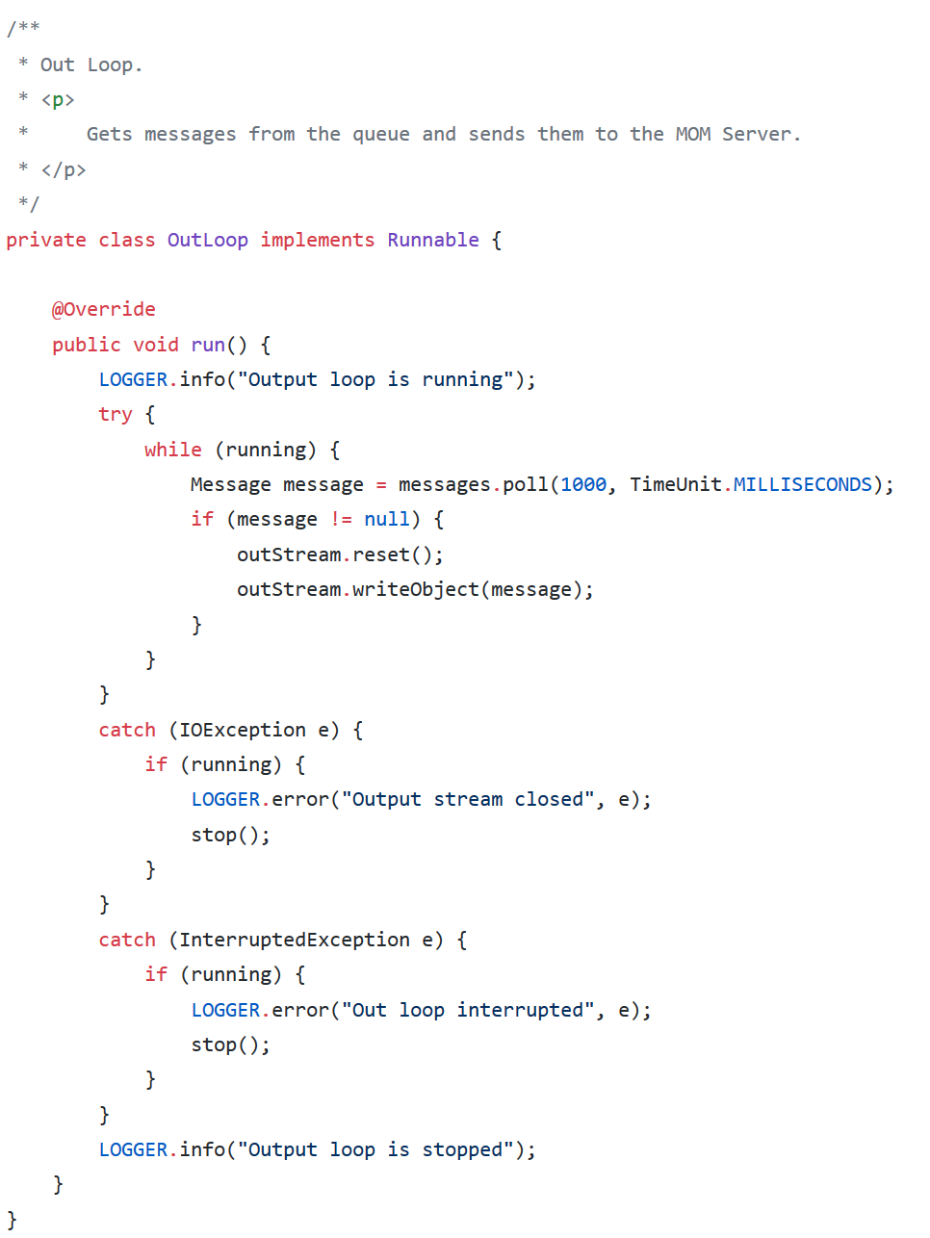

Slide 56
Bibliography
Ruh, W. A., Maginnis, F.X., Brown, W.J., "Enterprise Application Integration", Wiley e-book.
Bottle: http://bottlepy.org/docs/dev/
Scikit-learn: https://scikit-learn.org
MOM in Java: https://docs.oracle.com/cd/E19148-01/819-4470/gbpdl/index.html

